Slide 1
Section 8 ─ Unit 3
CNC Turning: Programming

Slide 2
Introduction
No standardized format for writing a CNC program
Each MCU manufacturer has unique programming format
All use same ideas
‏

Slide 3
Coordinate Positioning for Turning
Coordinate positions for turning:
  Two methods for programming X-axis coordinates: diametral or radial

Slide 4
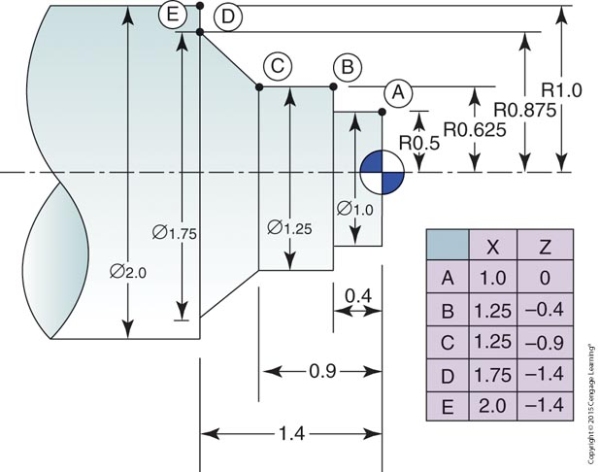
FIGURE 8.3.1 In this example the X-axis coordinates are derived diametrally.

Slide 5
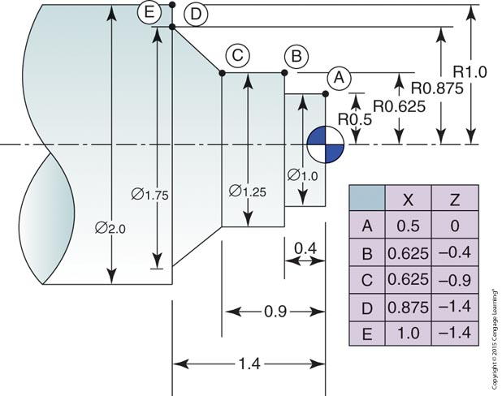
FIGURE 8.3.2 In this example the X-axis coordinates are derived radially.

Slide 6
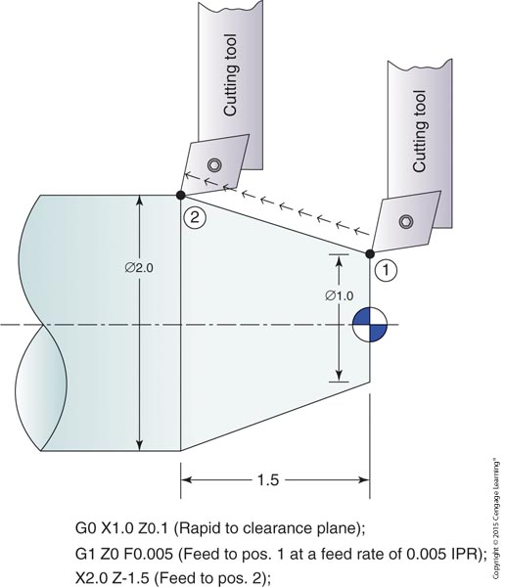
Types of Motion for Turning
Rapid travers (G0), linear interpolation (G1), circular interpolation (G2 and G3)‏
FIGURE 8.3.3 In a turning machine linear motion between two points can be used to create a straight diameter or a taper (shown).

Slide 7
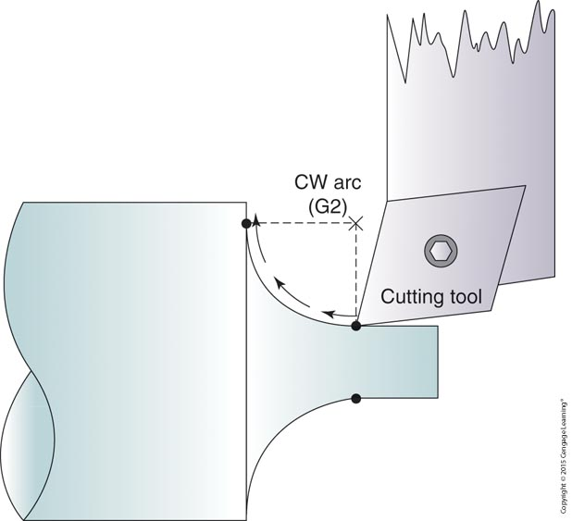
FIGURE 8.3.4 When the cutting tool is oriented behind the workpiece, a G2 creates a fillet radius (concave radius).

Slide 8
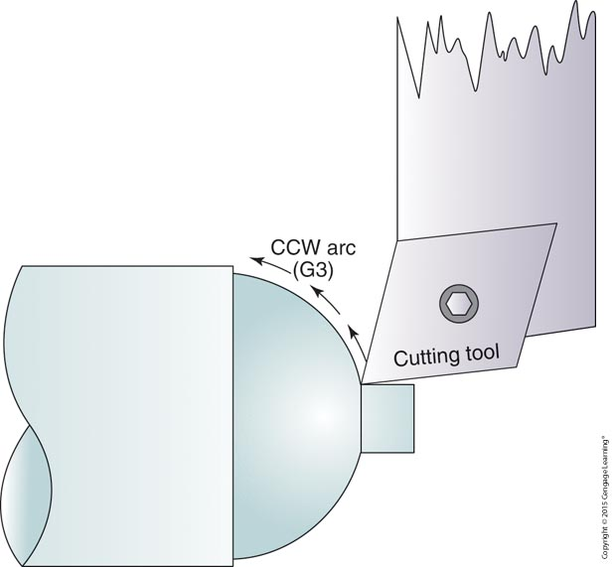
FIGURE 8.3.5 When the cutting tool is oriented behind the workpiece, a G3 creates an outside corner radius (convex radius).

Slide 9
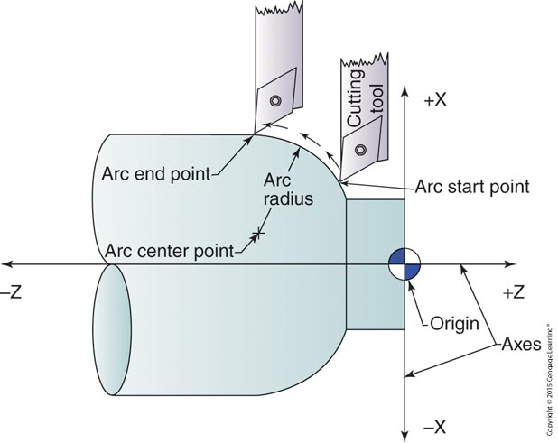
FIGURE 8.3.6 The parts of an arc are shown.

Slide 10
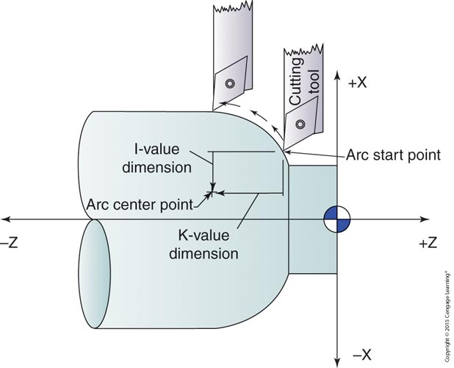
FIGURE 8.3.7 The arc center location is identified by the I- and K-words as shown.

Slide 11
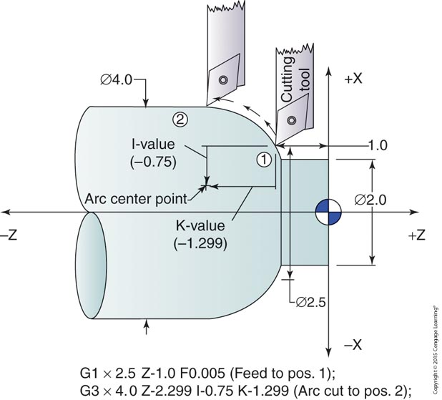
FIGURE 8.3.9 The code for cutting the arc using the arc center method is shown.

Slide 12
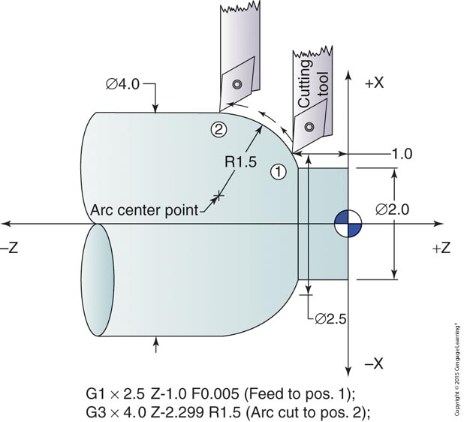
FIGURE 8.3.11 The code for cutting the arc using an R-word is shown.

Slide 13
Non-Axis Motion Commands
Commands:
  Spindle speed for turning
  Tool-change commands
  Sequence numbers
  Program stop commands
  Summary of safe-start, spindle-start, and tool-change/offset commands

Slide 14
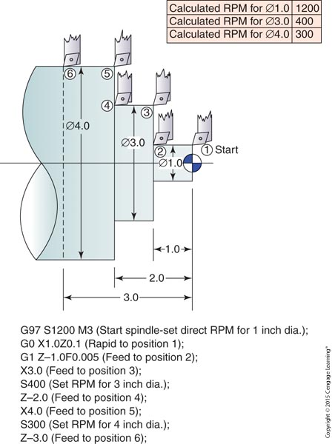
FIGURE 8.3.13 The spindle RPM must be recalculated and reprogrammed for every diameter change when using direct RPM mode. An example of a part and the corresponding program sample is shown.

Slide 15
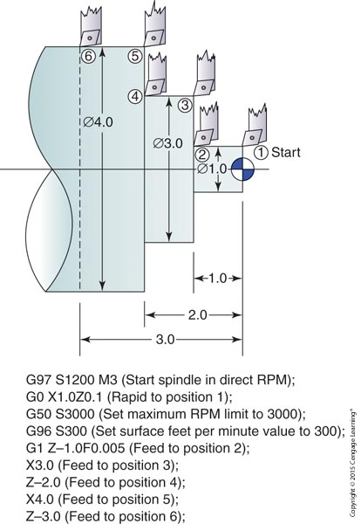
FIGURE 8.3.14 The spindle RPM will be automatically adjusted for the diameter being cut when using constant surface speed (G96). The RPM is calculated based on the X-axis position of the cutting tool. An example of a part and the corresponding program sample is shown.

Slide 16
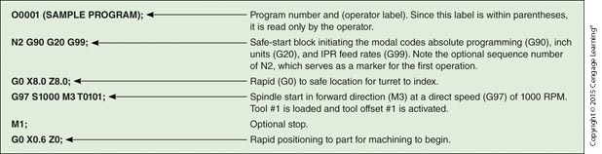

Slide 17
Machining Operations
Coolant M-codes
  Used to turn coolant off and on
Facing
  A flat surface perpendicular to center line
Drilling operations
  Many turned products include hole work
Straight turning
  Outside diameter cut as one straight diameter

Slide 18
Machining Operations (cont’d.)
Taper turning
  Moving two axes at the same time
Contour turning
  Produces intricate profiles called contours
Roughing operations
  Passes to remove the bulk of the material
Finishing
  Fine surface finish; dimensional accuracy

Slide 19
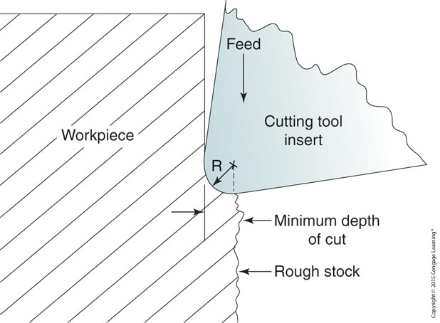
FIGURE 8.3.16 When using inserted carbide tooling, enough material should be taken during the finish pass to engage the tool at least to a depth of the full tool nose radius.

Slide 20
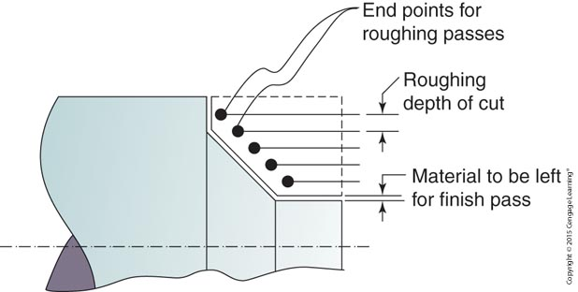
FIGURE 8.3.22 Roughing passes must be made carefully to ensure that they do not gouge into a surface to be finished later.

Slide 21
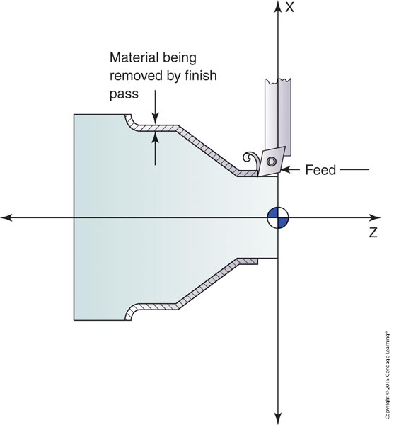
FIGURE 8.3.23 A finish pass is taken to produce the final finished part sizes. This operation removes the material left on the part during the roughing operation.

Slide 22
Canned Cycles
Packaged code makes tedious/repetitive machining operations faster and easier to program
  Holemaking, tapping, rough and finish turning, and threading canned cycles
Compensate for nose radius of carbide inserts on cutting tools

Slide 23
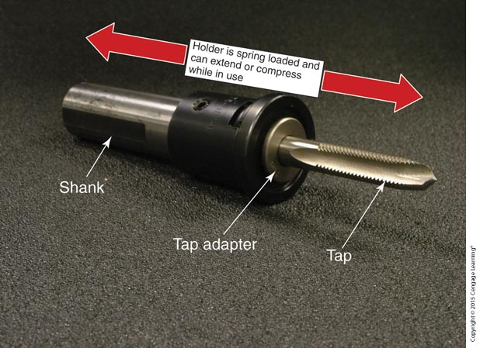
FIGURE 8.3.25 A floating tap holder.

Slide 24
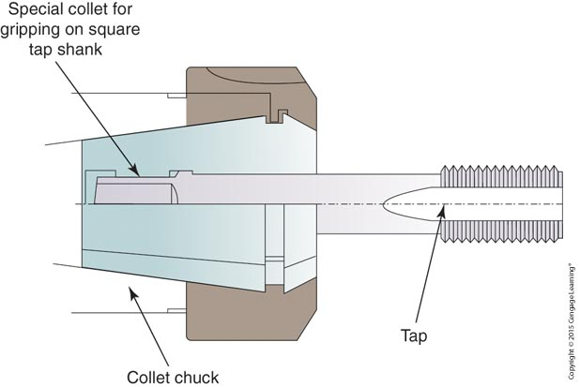
FIGURE 8.3.27 A collet chuck and special collet used for rigid tapping.

Slide 25
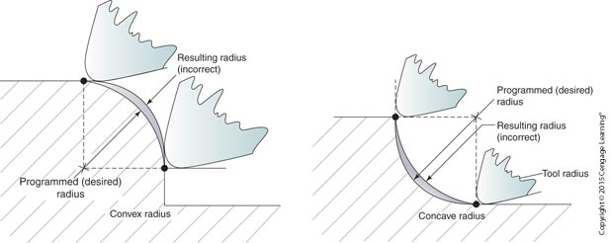
FIGURE 8.3.31 Illustration of how a tool nose radius will cause error when cutting a convex radius and a concave radius.

Slide 26
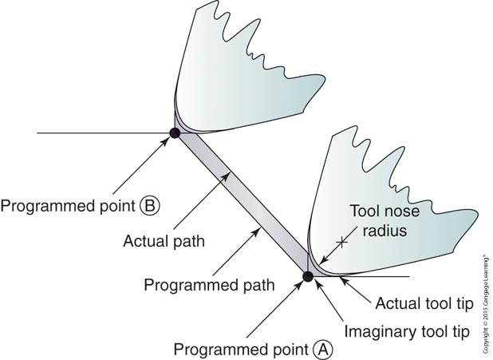
FIGURE 8.3.32 Illustration of how a tool nose radius will cause error when making an angular cut on a turned workpiece.

Slide 27
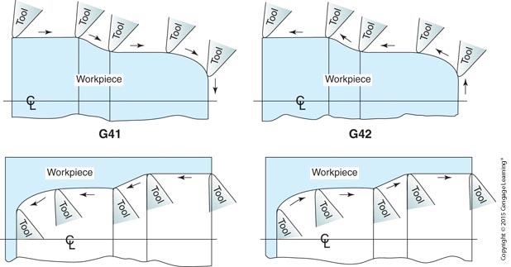
FIGURE 8.3.33 Examples of when to use G41 and when to use G42 codes.

Slide 28
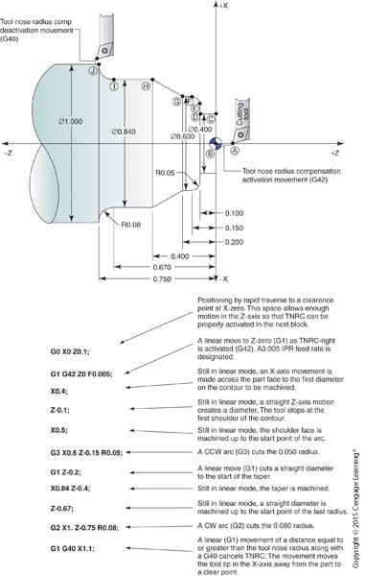
FIGURE 8.3.34 A finish contouring pass is performed using tool nose radius compensation.

